Slide 1
Finance Forum
Finance Risk Management and Horizon Scanning
Chris Coopman – Financial Controller, RABI
David Locke – Director of Finance and Operations, RABI

Slide 2
Agenda
Risk Management– why?
Risk Management– why?
Risk Matrix – CC26
Current risks (discussion)
Horizon Scanning – models (discussion)
Disaster Resilience
Notes:
To discuss how finance functions currently manage risk and horizon scan for the finance function (specifically)

Slide 3
Risk Management – Why?
Why is risk management important?
What particular types of risk do charities face?
How can risk be managed?
What is disaster recovery planning?

Slide 4
Risk Management – Why?
significant risks are known and monitored, enabling trustees to make informed decisions and take timely action
the charity makes the most of opportunities and develops them with the confidence that any risks will be managed
forward and strategic planning are improved
the charity’s aims are achieved more successfully
Notes:
Just to note that not all risks are negative!

Slide 5
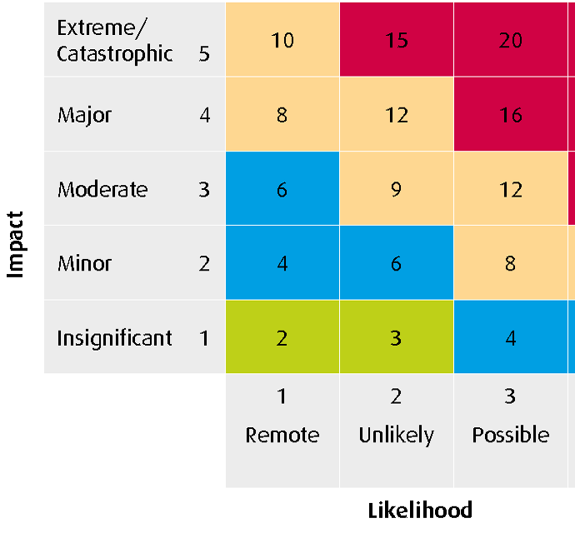
Risk Matrix (Charity Commission – CC26)
How do you currently manage risk (specifically in the finance function)?
e.g. risk register
Internal financial controls
Principles
Policy
Procedures

Slide 6
Current risks Discussion
Funding volatility
Regulatory Compliance
Fraud
Inadequate financial controls (inc. cybersecurity)
Economic downturn/investment risk
Dependency on donors
Sustainability
Inadequate reserves
What is the target risk parameter?
Notes:
are these risks managed and mitigated?
How is risk quantified?
What is the target risk level?

Slide 7
Horizon Scanning - (2010 PESTLE)
Political | Economical | Societal | Technological | Legal | Environmental
Debt ceiling crisis – US (now permanent!) US Tax Cut policy China/US trade war | Oil price volatility Cryptocurrency | Brexit Black Lives Matter | Digitalisation Flash Crash – 2010 Social Media | Charity Act | Covid Increasing catastrophic events
Notes:
Flip Chart

Slide 8
Horizon Scanning (2023 – PESTLE)
Political | Economical | Societal | Technological | Legal | Environmental
Tax policies | Inflation House Prices Bond Market | Demographic pressures Councils bankrupt | Digitalisation | Charity Act | Ethical Investing
Notes:
Flip Chart

Slide 9
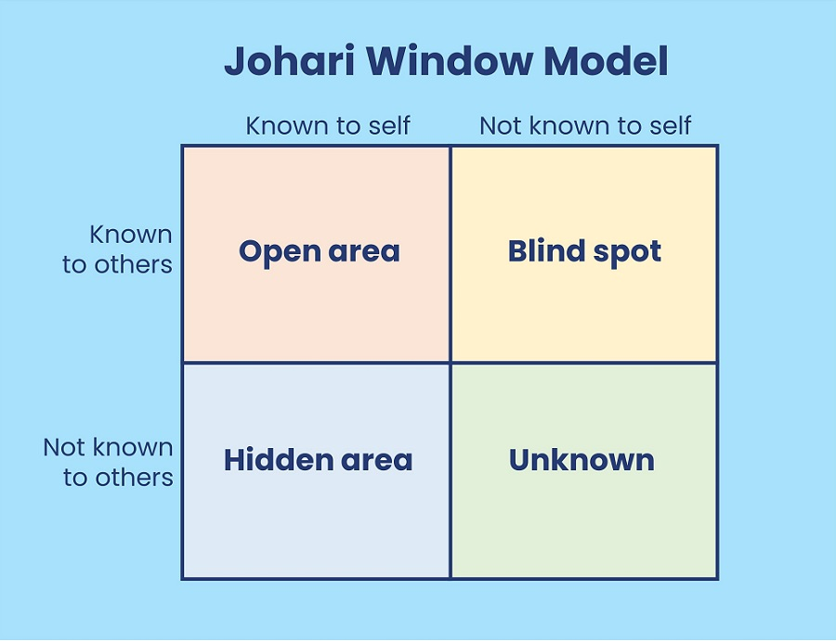
Horizon Scanning (Part 1)

Slide 10
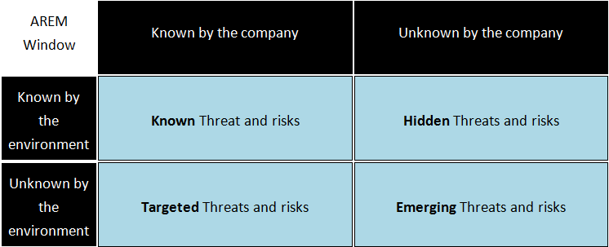
Horizon Scanning (Part 2)
Notes:
Johari

Slide 11
Disaster Resilient
People
Process
Technology
We have to be prepared for the ‘Unknown Unknowns’

Slide 12
Conclusion
Risk Management– why?
Risk Management– why?
Risk Matrix – CC26
Current risks (discussion)
Horizon Scanning – models (discussion)
Disaster Resilience
Notes:
To discuss how finance functions currently manage risk and horizon scan for the finance function (specifically)

Slide 13
Any questions?

Slide 14
Finance Forum
Finance Risk Management and Horizon Scanning
Chris Coopman – Financial Controller, RABI
David Locke – Director of Finance and Operations, RABI

